Slide 1

small footprint automatic speech recognition free keyword spotting
Presented by: Bijoyashree Das (23SP06004)
Under the guidance of: Dr Himanshu Pramod Padole
School of Electrical & Computer Sciences
Indian Institute of Technology Bhubaneswar
Date: 5th May, 2025

Slide 2
CONTENTS
Introduction
Problem statement
Work done so far
Proposition of current work
Proposed methodology
Experimental setup and results
Ablation studies
Conclusion and future work
References
SMALL FOOTPRINT AUTOMATIC SPEECH RECOGNITION (ASR)-FREE KEYWORD SPOTTING IN SPEECH
2

Slide 3
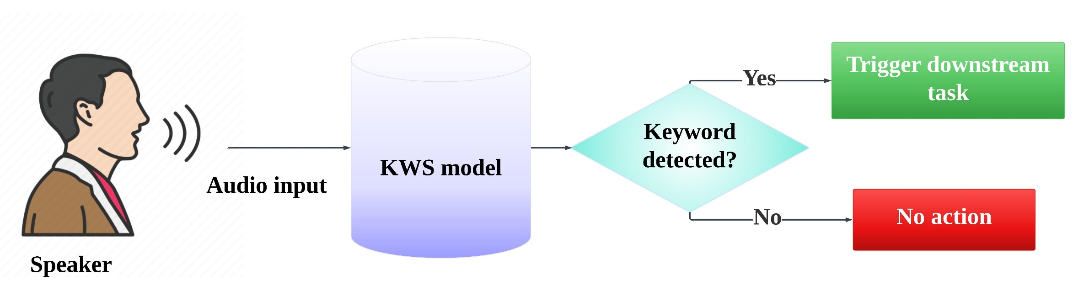
Introduction to keyword spotting
The goal of keyword spotting (KWS) is for the model to find particular terms in a voice stream, which can be used to trigger the predefined downstream task.
It is a part of modern voice-activated device modules that detect specific trigger words to function.
Common use cases include voice-activated assistants in smart home devices, in-car voice assistants, robotics, wearable devices, gaming, defense applications, voice-enabled interactive voice response (IVR), etc.
Figure 1: Standard keyword spotting system

Slide 4
Introduction to keyword spotting
Most of the KWS systems follow two basic approaches: automatic speech recognition (ASR)-based [1] [2], and automatic speech recognition (ASR)-free [3], [4], [5], [6], [7], [8], [9].
ASR-based Approach:
Translate the audio into text and then detect the keyword.
Often employ huge advanced neural network architectures requiring substantial computational resources, training on large language datasets, and cloud-based infrastructure.
Inherently language-specific and perform poorly on the low-resource languages.
ASR-free Approach:
Detect a keyword from the audio input solely using the audio characteristics, reducing the computational burden and memory requirements.
Attractive choice for lightweight, language-independent systems to function on stand-alone, low-resource devices.

Slide 5
Literature review
Reference | ASR-free approaches used
Rybakov et al. (2020) [3] | DNN model employing fully-connected layers with ReLU activation, a frame stacking mechanism, and a pooling layer, achieving 91.2% accuracy.
Huh Jaesung et al. (2021) [4] | Metric learning upon a ResNet-based baseline architecture to achieve an accuracy of 83.82%.
Berg et al., (2021) [5] | Transformer based model KWT-3 with accuracy of 97.49%.
Ewald et al. (2022) [6] | Trains a CNN using dynamic time warping scores, yielding an AUC of 83.28% for features extracted using a correspondence auto-encoder.
Parnami et al. (2022) [7] | Fewshot learning-based KWS exploiting a ResNet architecture and reported 94% accuracy.
A. Bittar (2024) [8] | Replaced the BC-ResNet encoder in the vision-inspired KWS framework with an I3D gated conformer for streaming audio, with 94.8% accuracy.
Sun et al. (2024) [9] | Swin transformer-based architecture with an accuracy of 87.49%, and TCN+Swin transformer yielded accuracy of 98.07%.
Table 1:Existing state-of-the-art KWS models

Slide 6
Problem statement
Recent ASR-free deep learning-based KWS models have demonstrated state-of-the-art performance with classification accuracies up to 98%.
However, they rely heavily on large architectures such as transformers, LSTMs, and attention modules.
This increases the training time, run time, memory, and computational resources.
Makes it challenging to deploy for a real-time application in low-resource environments like edge devices with limited memory and computational power.
Hence, we aim to design an efficient ASR-free KWS model that is language-independent, lightweight with low computational complexity and minimal training parameters, that would be feasible for deployment in small-footprint edge devices.

Slide 7
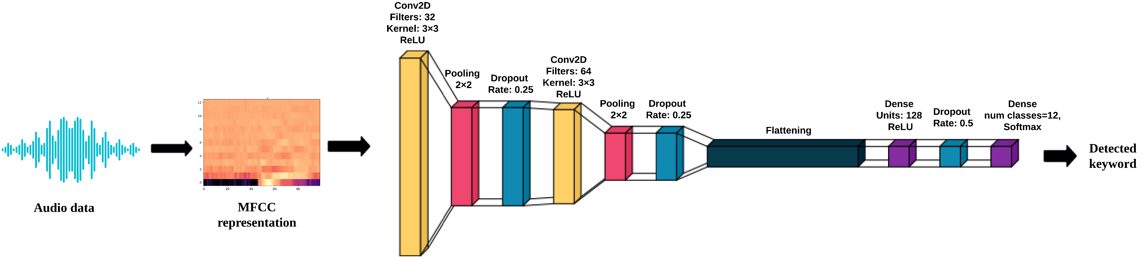
Work done till now
(a) MFCC-CNN-based KWS model
Figure 2: Representation of the basic MFCC-CNN KWS model
The raw audio files were divided into overlapping time frames (window size 25 ms and hop size 10 ms).
MFCC representation is generated from the windowed audio, to serve as a feature.
Results in a 2-D matrix of dimension 13 × 99, with 13 MFCC coefficients and 99 time-frames.
A CNN well-suited for handling the 2D nature of the resulting MFCC matrix, is employed for classification.

Slide 8
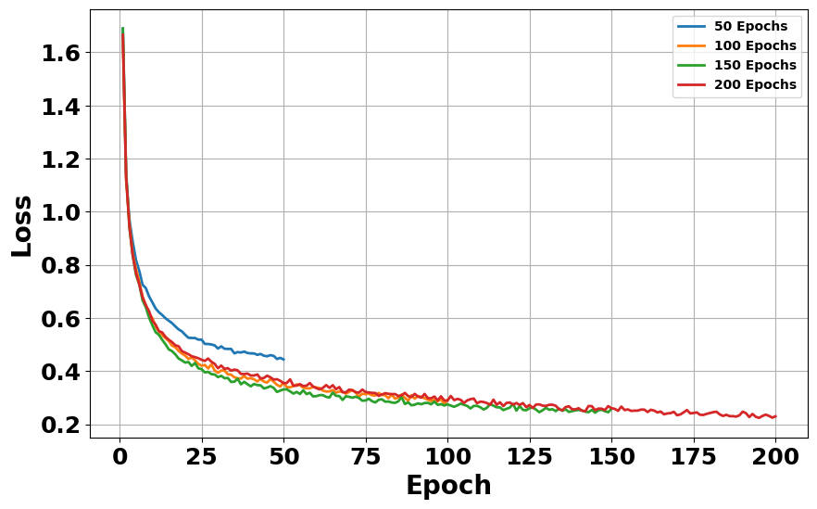
Work done till now
Layer | Configuration | Output Shape
Input | - | (1, 13, 99)
ConV2D | Filters: 64, Kernel: 3×3, ReLU | (64, 11, 97)
MaxPool2D | Pool size: 2×2 | (64, 5, 48)
Dropout | Rate: 0.25 | (64, 5, 48)
ConV2D | Filters: 128, Kernel: 3×3, ReLU | (128, 3, 46)
MaxPool2D | Pool size: 2×2 | (128, 1, 23)
Dropout | Rate: 0.25 | (128, 1, 23)
Flatten | - | (2944)
Dense | Units: 128, ReLU | (128)
Dropout | Rate: 0.5 | (128)
Dense | Units: num_classes=12, Softmax | (num_classes=12)
Epochs | Accuracy | Precision | Recall | F1-score
50 | 85.925 | 85.971 | 85.923 | 85.904
100 | 91.316 | 91.335 | 91.316 | 91.269
150 | 91.695 | 91.807 | 91.695 | 91.692
200 | 91.442 | 91.568 | 94.442 | 91.437
Table 3: Classification performance over varying number of epochs.
Table 2: Architecture details of the basic MFCC-CNN-based KWS model.
Although this basic KWS model performed reasonably well, it considers the MFCC matrix as a 2-D image.
Neglects the temporal evolution of the MFCC coefficients in the inherently time-evolving audio data.
Therefore, a time series classification-based KWS model is proposed that exploits the intrinsic time series nature of the audio data.
Figure 3: Training loss over different epoch values.

Slide 9
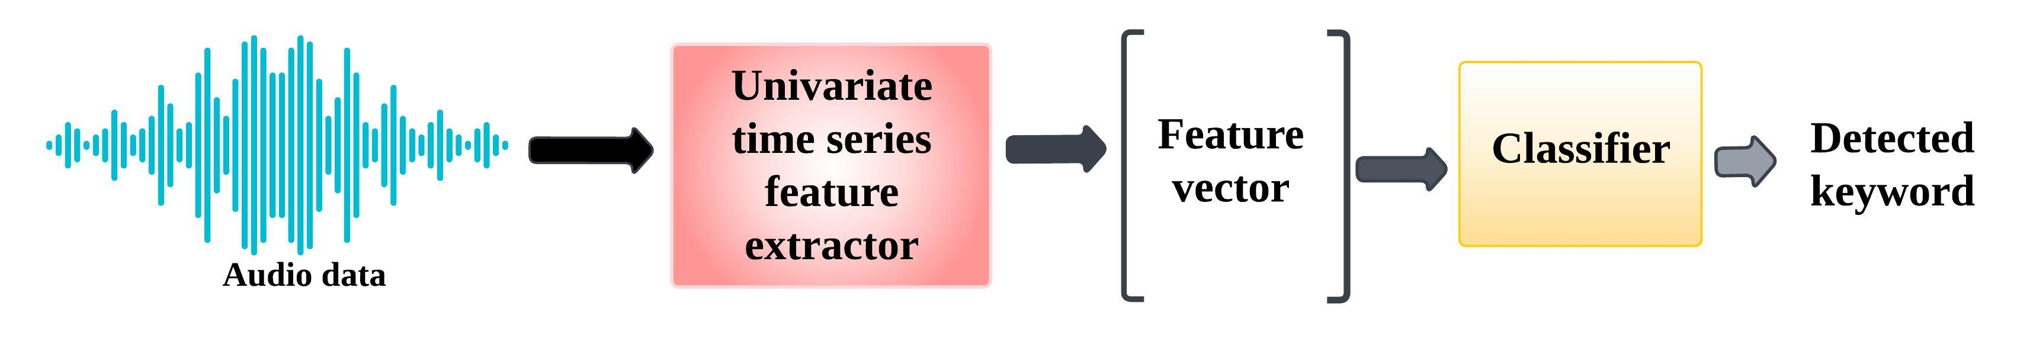
WORK DONE TILL NOW
(b) Univariate time series classification (UTSC)-based KWS model
UTSC Algorithm [11] | Accuracy (%)
ROCKET | 77.8844
RDST | 77.6674
HYDRA | 71.469
MR-HYDRA | 72.7456
QUANT | 66.2574
Dr-CIF | 64.8974
FreshPRINCE | 68.1346
Catch22 | 48.1494
TSF | 44.1776
RISE | 49.4331
Figure 4: Block diagram of the proposed UTSC-based KWS model.
For the first time, we bring the time series classifiers into use for KWS.
KWS is formulated as a time series classification with audio as an input and keywords as the target classes.
Different time series-specific feature extractors are used for time series feature extraction.
Extracted features are used to train classifiers for keyword detection.
However, the model can not explicitly exploit the acoustic features like MFCC.
Table 4: Classification performance of UTSC-based KWS model using different time series feature extractors.

Slide 10
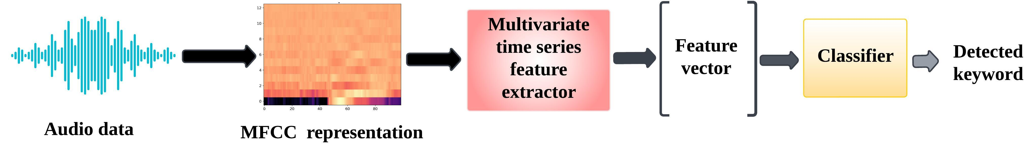
Work done till now
(c) Multivariate time series classification (MTSC) based KWS model (without parameter reduction)
MTSC Algorithm [11] | Accuracy (%)
ROCKET | 89.7996
RDST | 93.6270
HYDRA | 87.1998
MR-HYDRA | 87.3803
QUANT | 77.1258
Dr-CIF | 81.0000
FreshPRINCE | 76.3352
Catch22 | 72.5762
TSF | 76.1328
RISE | 28.0014
Figure 5: Block diagram of the proposed MTSC-based KWS model (without parameter reduction)
Combines strengths of acoustic features like MFCC with time series-specific feature extractors.
The univariate audio time series data is transformed into a 2-D MFCC matrix obtained from windowed audio (window size of 25 ms and hop size of 10 ms).
Resulting 13×99 dimensional MFCC matrix is modelled as a 13-dimensional time series of length 99, representing the temporal evolution of 13-MFCC coefficients.
Used different multivariate time series feature extractors to get the feature space representations that serves as the inputs to different classifiers.
Table 5: Classification performance of MTSC-based KWS model using different
time series feature extractors

Slide 11
Proposition for current work
Extract the windowed-MFCC features from the audio to exploit its acoustic features.
Incorporate the time series classification-based keyword spotting model that exploits the inherent time evolving nature of the audio data.
Multivariate extension of the model with optimized specifications to achieve better accuracy.
Reduce the model parameters for maintaining small footprint.
Combine the strengths of different time series feature extractors using feature fusion approach.

Slide 12
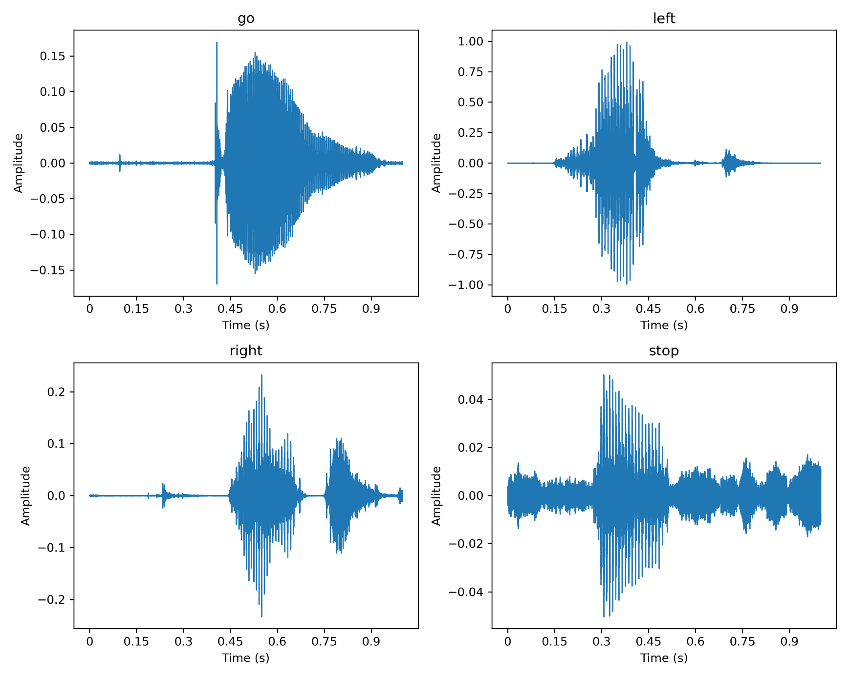
Datasets used
Google Speech Command (GSC) V1 and V2 [12]
The dataset consist of 1-second audio snippets sampled at 16kHz.
The V2 contains 105,000 samples of 35 distinct words, whereas the V1 contains 65,000 samples of 30 different words
The classification model in this study utilized ten command words: “up”, “down”, “left”, “right”, “yes”, “no”, “on”, “off”, “go”, and “stop” as the target keywords.
In addition two classes, viz., “silence”, and “unknown”.
Free Spoken Digit (FSD) Dataset [13]
3,000 audio samples of spoken digits from 0 to 9, recorded at a sampling rate of 8kHz.
Each snippet is 1-second long.
Additionally, “unknown” and “silence” classes have been added similar to that of the GSC.
Figure 6: Sample audio input files from GSC V1

Slide 13
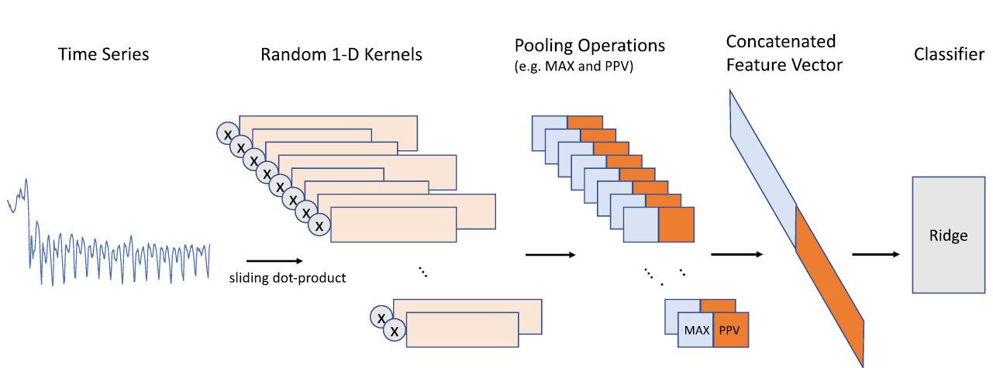
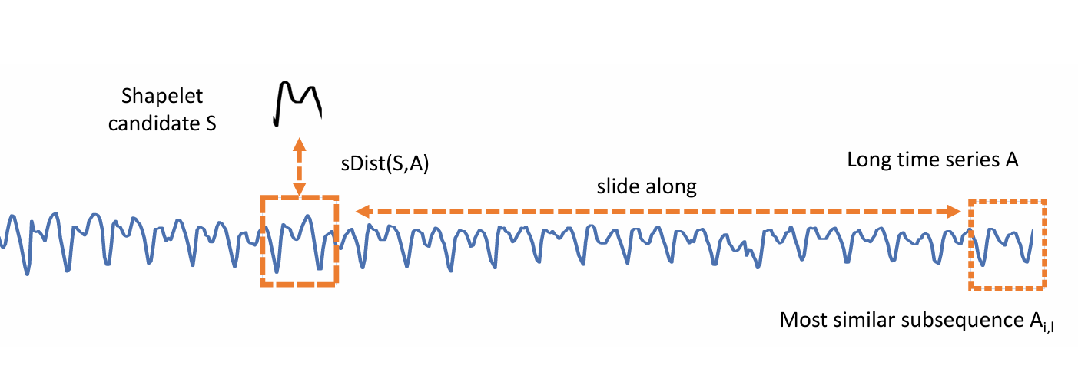
Time series classifiers (TSC)
ROCKET [14]
RDST [15]
The maximum value and the proportion of positive values (PPV) are the two pooling techniques used to extract features. The feature vector for a set of ‘k’ kernels has ‘2k’ features.
The extracted features include minimal distance discovered for that shapelet, its location and a threshold-based indicator of the shapelet’s frequency of occurrences. The feature vector for a set of ‘k’ shapelets has ‘3k’ features.
Figure 8: Finding the minimum among the distances between a shapelet S and all finite length subsequences of the time series A [11]
Figure 7: Processing pipeline of ROCKET [11]

Slide 14
Improving feature extraction
Deciding the optimal number of kernels and shapelets affects the time series feature extraction and hence the detection performance.
To verify this, experimentation was performed by varying their default values.
KWS model based on MTSC algorithm | Kernels/ Shapelets | Performance Metrics for GSC V1
 |  | Accuracy | Precision | Recall | F1-Score
ROCKET | 10K | 89.7996 | 89.8721 | 89.9091 | 89.8648
 | 20K | 93.4645 | 93.5073 | 93.5174 | 93.4890
 | 30K | 94.3852 | 94.4188 | 94.4175 | 94.3952
 | 50K | 94.7102 | 94.7543 | 94.7368 | 94.7200
 | 100K | 94.9629 | 94.9781 | 95.0160 | 94.9776
 | 120K | 95.0171 | 95.0503 | 95.0648 | 95.0277
RDST | 10K | 93.6270 | 93.7773 | 93.6418 | 93.6600
 | 30K | 94.8366 | 94.9713 | 94.8888 | 94.9088
 | 50K | 95.1435 | 95.2802 | 95.1829 | 95.2094
 | 70K | 95.0171 | 95.1595 | 95.0688 | 95.0942
Table 6:Classification performance of ROCKET and RDST-based MTSC KWS models for varying input parameters

Slide 15
Challenges with increased kernels/shapelets
ROCKET with increased 120K kernels, and RDST with increased 50K shapelets performed the best with the accuracies of 95.02% and 95.14%, respectively.
Although the increased number of kernels and shapelets improves the classification accuracy, it also increases the resulting number of features to:
2×120K = 240K for ROCKET and 3×50K = 150K for RDST.
These feature vectors, when provided to the optimal 12-class ridge classifier, results in an increased number of trainable parameters. Specifically,
For ROCKET:
Total trainable parameters = 12 × 240K + 12 = 2880012 = 2.88M.
For RDST:
Total trainable parameters = 12 × 150K + 12 = 1800012 = 1.80M.

Slide 16
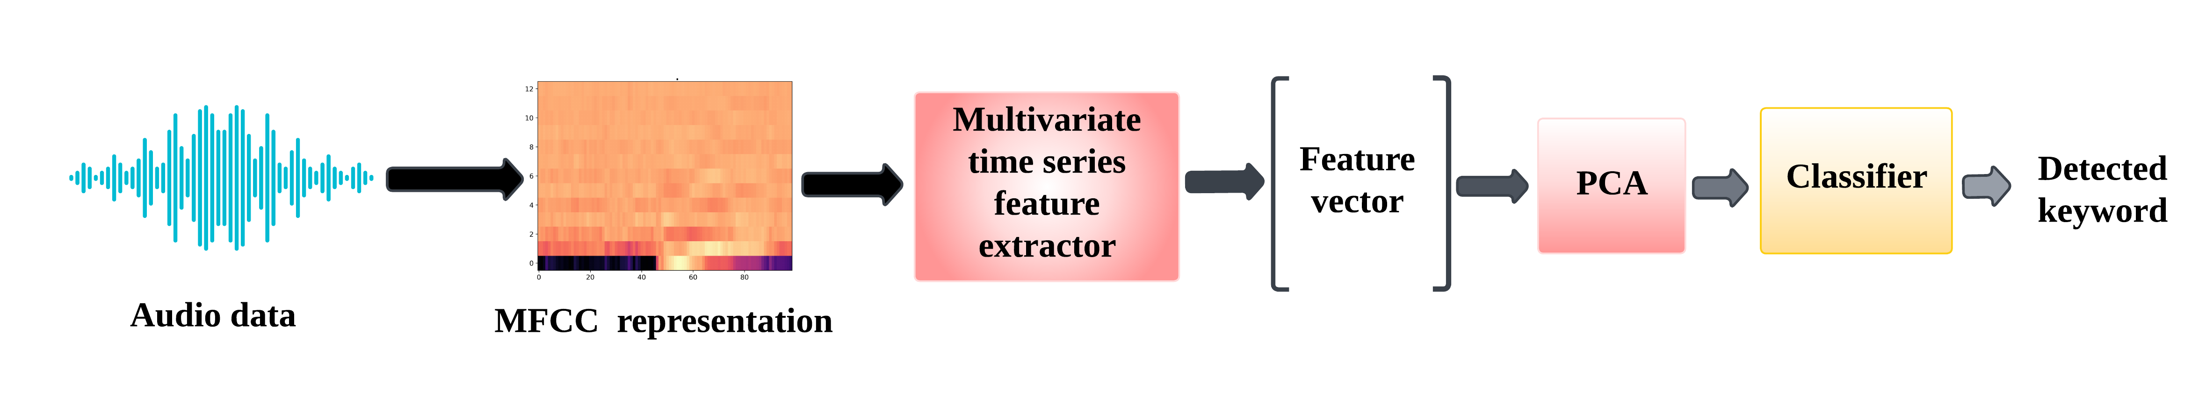
Modified MTSC based KWS model
The huge number of trainable parameters increases the model’s complexity.
Restricts the applicability to resource-constrained systems like edge devices.
To circumvent this, the number of model parameters is brought down using dimensionality reduction.
Specifically, principal component analysis (PCA), is applied to the original feature vector before feeding it to the classifier.
Figure 9: Block diagram of the modified proposed MTSC-based KWS model with PCA reduction

Slide 17
Modified MTSC based KWS model
For the MTSC ROCKET-based KWS model
Features reduced from 240K to 20K
Classifier parameters from 2.88M to 240K leading to 12 times reduction
For the MTSC RDST-based KWS model
Features reduced from 150K to 5K
Classifier parameters from 1.80M to 60K leading to 30 times reduction
KWS model based on MTSC algorithm | PCA components/ Feature size | Trainable parameters | Performance Metrics for GSC V1
 |  |  | Accuracy | Precision | Recall | F1-Score
ROCKET | 20K | (20K × 12) + 12 = 240012 = 240K | 94.8185 | 94.8519 | 94.8635 | 94.8213
 | 10K | (10K × 12) + 12 = 120012 = 120K | 94.7463 | 94.8098 | 94.7726 | 94.7707
 | 5K | (5K × 12) + 12 = 60012 = 60K | 94.6199 | 94.6877 | 94.6555 | 94.6206
RDST | 20K | (20K × 12) + 12 = 240012 = 240K | 93.1034 | 93.3064 | 93.1309 | 93.1705
 | 10K | (10K × 12) + 12 = 120012 = 120K | 93.3200 | 93.5130 | 93.3310 | 93.3603
 | 5K | (5K × 12) + 12 = 60012 = 60K | 93.3562 | 93.5421 | 93.3516 | 93.3602
Table 7: Classification performance of MTSC-based KWS models with different PCA components.

Slide 18
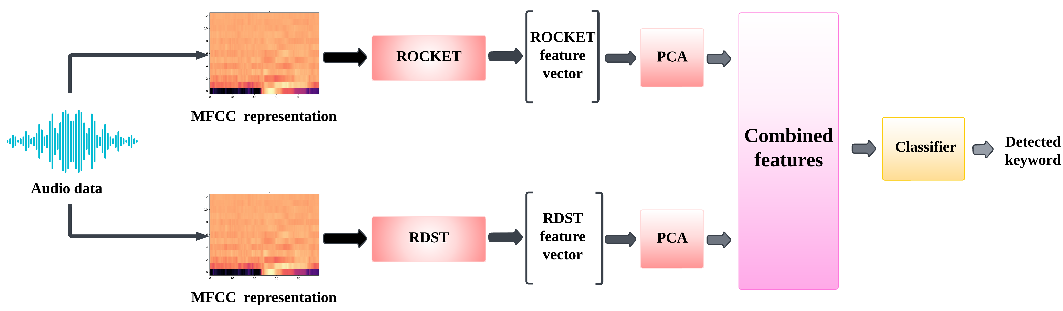
Integrated ROCKET+RDST based MTSC KWS model
The individual keyword detection capabilities of the proposed MTSC KWS models are promising.
To combine the strengths of both, an integrated MTSC-based KWS model is proposed employing feature fusion.
The concatenated feature fuses the ROCKET’s kernel-based information with the RDST’s shapelet-based information to train different classifiers.
Figure 10: Block diagram of the proposed integrated MTSC-based KWS model.

Slide 19
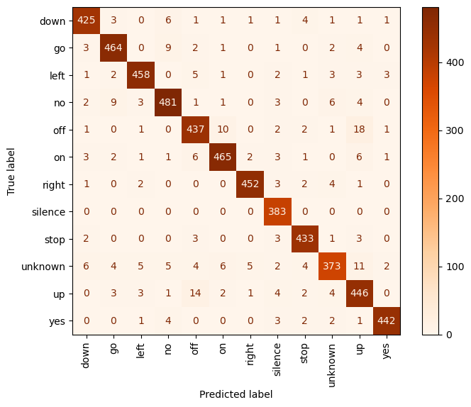
Integrated ROCKET+RDST based MTSC KWS model
KWS model based on MTSC algorithm | PCA components | Trainable parameters | Performance Metrics for GSC V1
 |  |  | Accuracy | Precision | Recall | F1-Score
ROCKET RDST | 20K 5K | (20K + 5K) × 12 + 12 = 300012 = 300K | 94.9449 | 94.9643 | 94.9935 | 94.9558
ROCKET RDST | 5K 5K | (5K + 5K) × 12 + 12 = 120012 = 120K | 94.4755 | 94.5719 | 94.5008 | 94.5068
Table 8: Classification performance of integrated MTSC-based KWS model with different PCA components
The integrated KWS model performed the best surpassing the non-integrated model’s performances with ~95% accuracy on GSC V1.
This essentially validated our idea of fusing different time series features to benefit from their complementary information.
Figure 11: Confusion matrix for integrated MTSC-based KWS model.

Slide 20
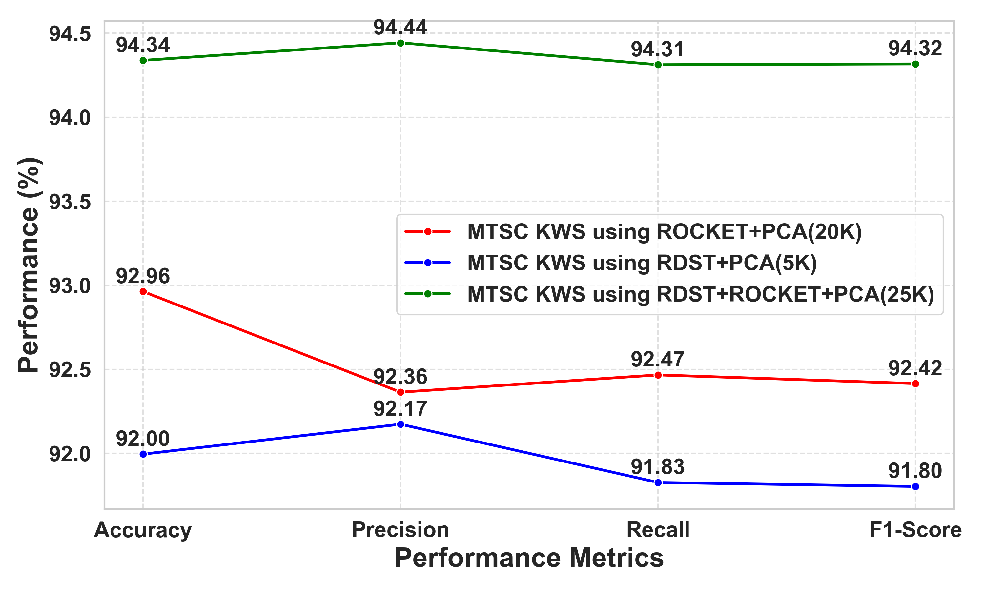
Performance on GSC V2
To attest to the generalizability of the models, their performance was examined on GSC V2.
The integrated MTSC-based KWS model on this dataset achieved an accuracy of 94.34%.
This validated its applicability in practical scenarios.
Figure 12: Classification performance of the proposed KWS models on GSC V2 dataset.

Slide 21
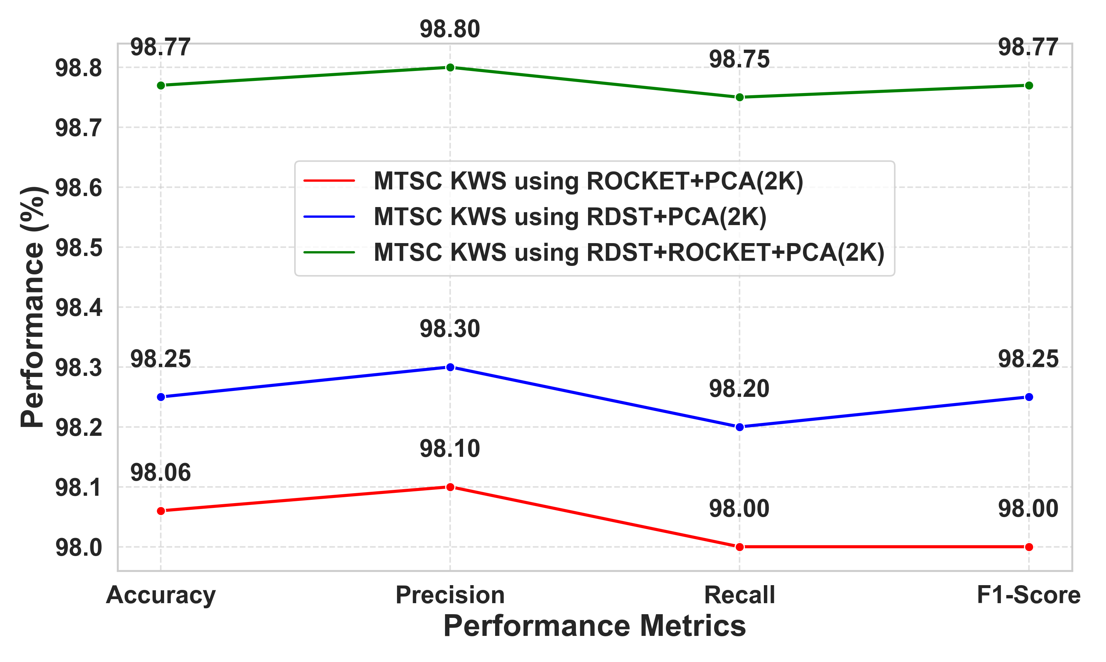
Performance on FSD
KWS model based on MTSC algorithm | Kernels/ Shapelets | PCA components | Trainable parameters | Accuracy
ROCKET | 50K | 2K | 24K | 98.06
RDST | 50K | 2K | 24K | 98.25
ROCKET+RDST | 25K+25K | 2K | 24K | 98.77
Table 9: Accuracies obtained for integrated MTSC-based KWS model with different PCA components on FSD dataset
Figure 13: Classification performance of the proposed KWS models on FSD.

Slide 22
Performance comparison with existing methods
Further, we compare the proposed model’s performance with that of the existing state-of-the-art KWS methods.
The proposed integrated MTSC-based KWS model outperforms most of the existing KWS methods (except for the two transformer-based models: 3 and 7).
Sl no. | Models | Accuracy (%)
1 | Enhanced DNN with Frame Stacking and Pooling [3] | 91.20
2 | Metric Learning on ResNet-Based Baseline [4] | 83.82
3 | KWT-3 [5] | 97.49
4 | Few-Shot Learning-Based KWS [7] | 94.00
5 | Vision Transformer-Based KWS [8] | 94.80
6 | Swin-Transformer [9] | 87.49
7 | TCN + Swin-Transformer [9] | 98.01
8 | DenseNet Structure [10] | 92.80
9 | MTSC ROCKET+PCA based KWS model(Ours) | 94.82
10 | MTSC RDST+PCA based KWS model (Ours) | 93.36
11 | Integrated MTSC ROCKET+RDST+PCA based KWS model(Ours) | 94.95
Table 10: Classification performance of different KWS methods

Slide 23
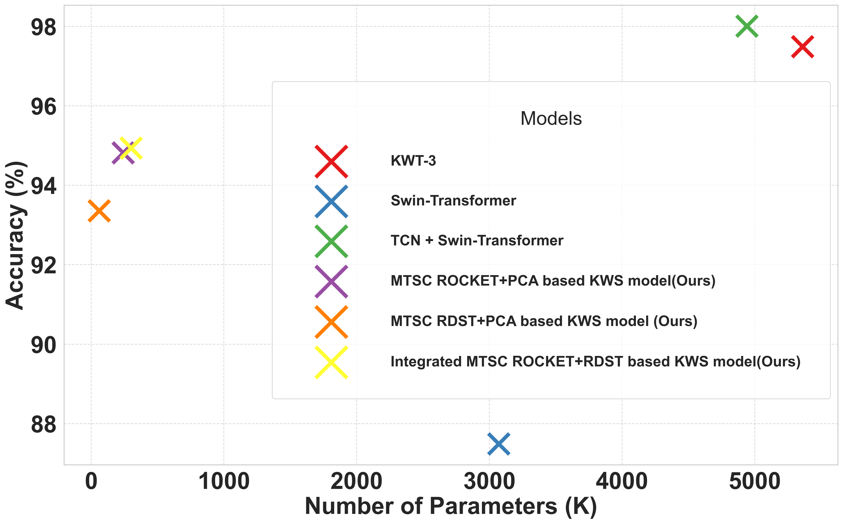
Performance comparison (MODEL parameters)
Model | Parameters
KWT-3 model | 5.36M
Swin-Transformer-based model | 3.07M
TCN+Swin-Transformer-based model | 4.94M
MTSC ROCKET+PCA based KWS model | 240K
MTSC RDST+PCA based KWS model | 60K
Integrated MTSC ROCKET+RDST+PCA based KWS model | 300K
Table 11: Trainable parameters different KWS methods.
Reduction in model parameters: 10-15 times
Reduction in accuracy: ~3%
Figure 14: Comparison of trainable parameters vs achieved accuracies for different KWS methods.

Slide 24
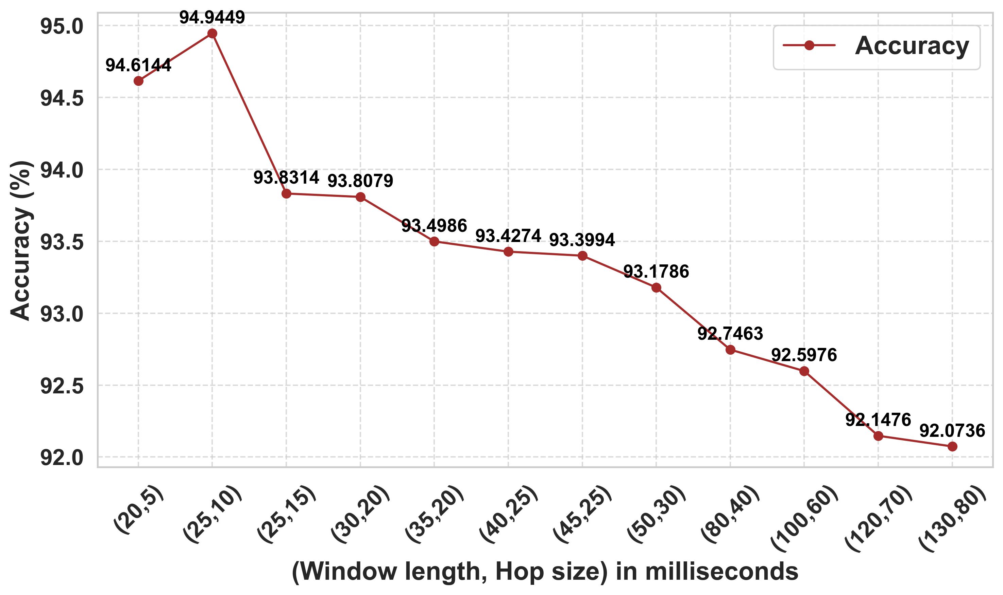
ABLATION STUDIES
Optimal window length and hop size selection
Figure 15: Line graph showing effect of varying window size and hop size combinations to achieve optimum accuracy

Slide 25
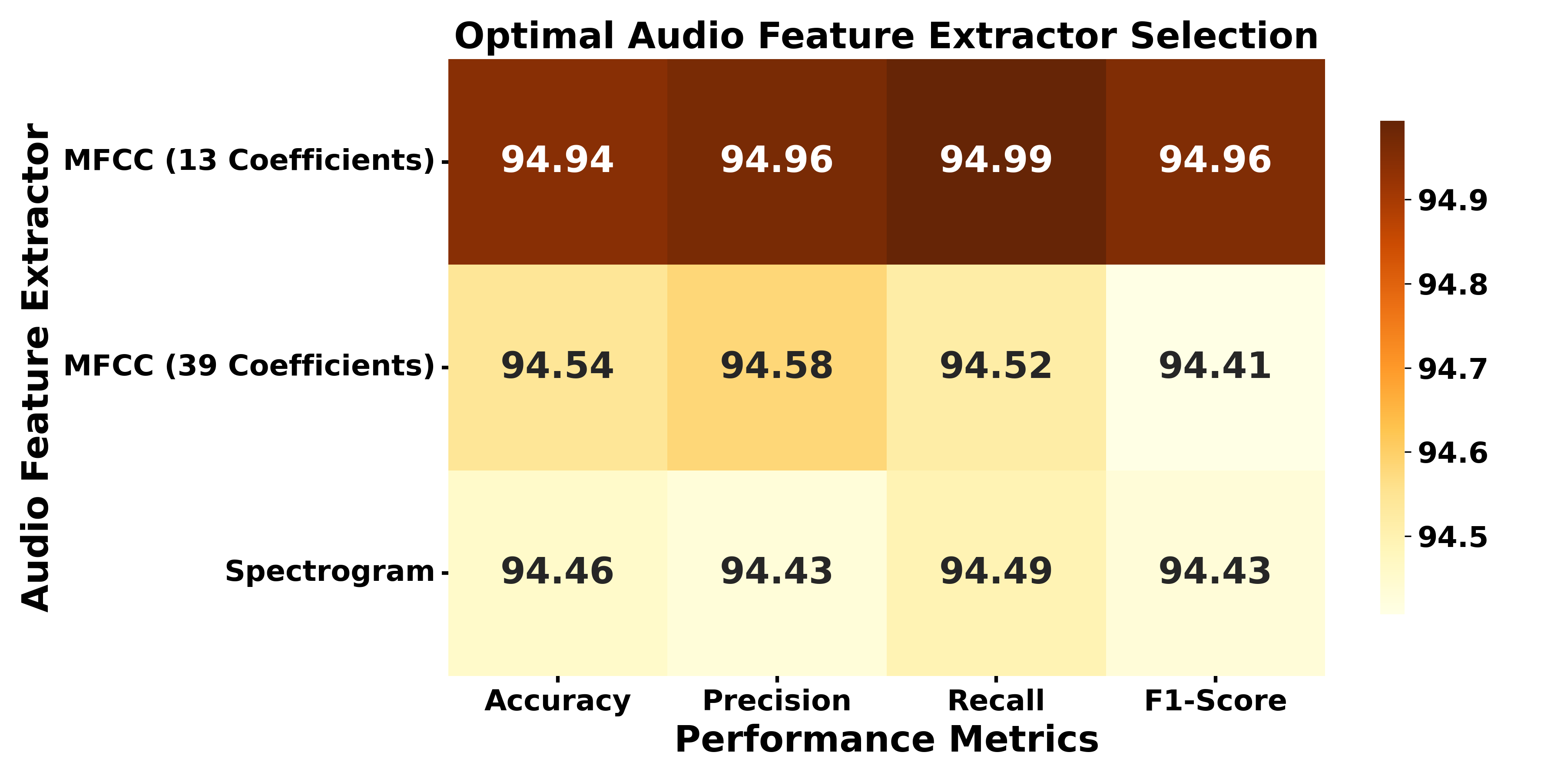
ABLATION STUDIES
Acoustic feature selection
Figure 16: Classification performance of MTSC-based KWS model using different acoustic features.

Slide 26
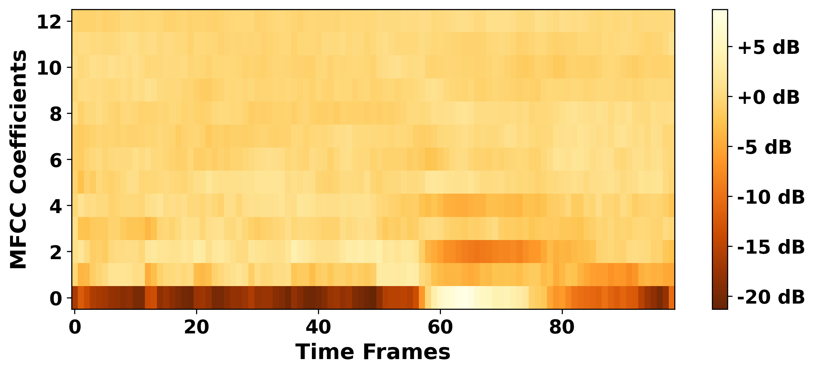
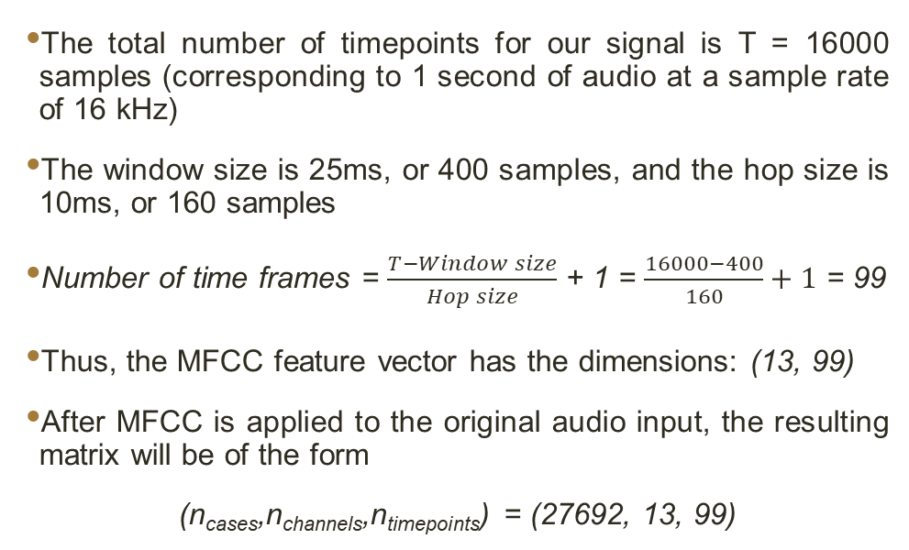
ABLATION STUDIES
Feature vector dimension calculation
MFCC feature vector dimension = [MFCC coefficients, Number of time frames]
The total number of timepoints for our signal is T = 16000 samples (corresponding to 1 second of audio at a sample rate of 16 kHz)
The window size is 25ms, or 400 samples, and the hop size is 10ms, or 160 samples
Number of time frames = $\frac{T−Window size}{Hop size}$ + 1 = $\frac{16000−400}{160}+1$ = 99
Thus, the MFCC feature vector has the dimensions: (13, 99)
After MFCC is applied to the original audio input, the resulting matrix will be of the form
(n_{cases},n_{channels},n_{timepoints}) = (27692, 13, 99)
Figure 17: MFCC visualization for an audio sample

Slide 27
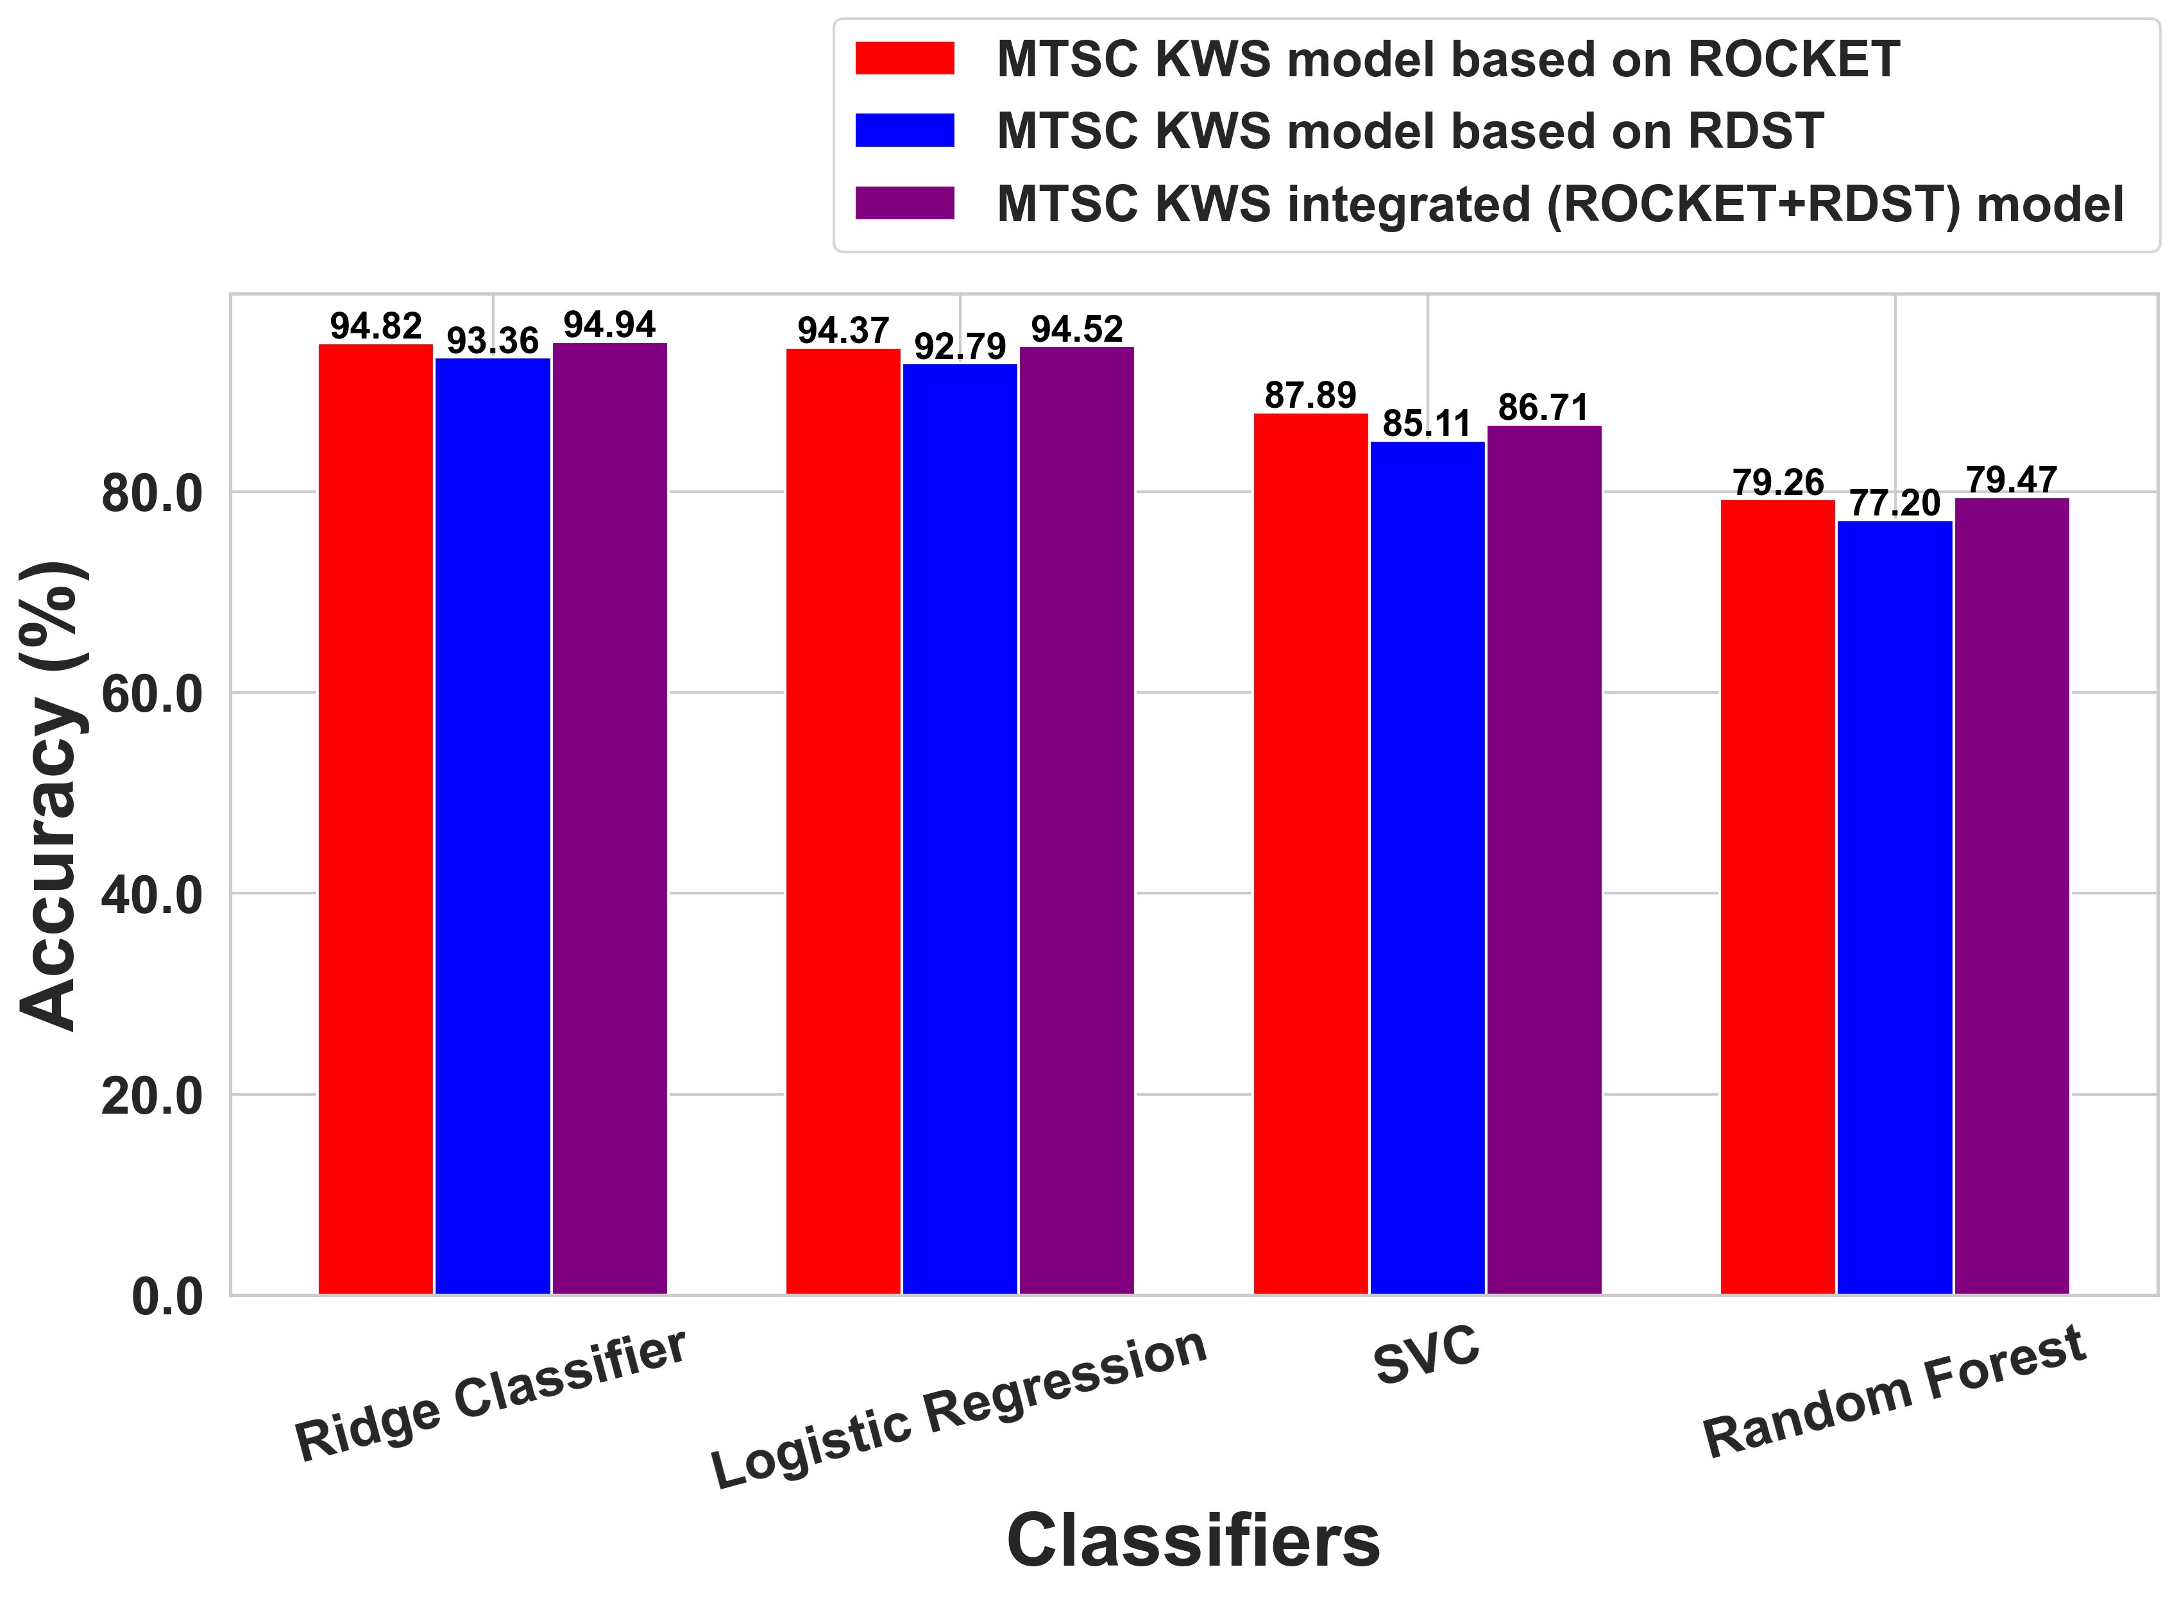
ABLATION STUDIES
Optimal classifier selection
Figure 18: Classification accuracy comparison of ROCKET and RDST-based MTSC KWS models using different classifier.

Slide 28
CONCLUSION
KWS problem is uniquely formulated as a univariate/multivariate time series classification task.
Univariate TSC based model exploits unsupervised time series specific feature extractors considering only temporal evolution of speech.
Multivariate TSC based model uniquely exploits acoustic features along with the temporal characteristics.
The integrated MTSC-based model obtained by feature fusion achieves an impressive accuracy of ~95% on the GSC V1 and 98.77% on FSD with only 300K parameters.
In contrast to state-of-the-art deep learning-based models, this achieves 10-15 times reduction in model parameters maintaining a comparable performance.
This small-footprint, language-agnostic, ASR-free keyword spotting model can be thus deployed in low-resource environments like edge devices with limited computation power and memory.

Slide 29
FUTURE WORK
The current models have utilized only MFCC and spectrograms for acoustic feature extraction.
Hence, other time-frequency representations, optimal for the present application, can also be explored.
Further, the current models employed only PCA for reducing the feature dimensions.
Other sophisticated compression techniques like encoders can also be exploited, although this may increase the overall model complexity, which will need further optimizations.

Slide 30
References
A. H. Michaely, X. Zhang, G. Simko, C. Parada, and P. Aleksic, "Keyword spotting for Google Assistant using contextual speech recognition” in Proc. IEEE Automatic Speech Recognition and Understanding Workshop (ASRU), Okinawa, Japan, 2017, pp. 272–278, doi:10.1109/ASRU.2017.8268946.
I. Lopez-Espejo, Z.-H. Tan, J. H. L. Hansen, and J. Jensen, "Deep spoken keyword spotting: An overview," IEEE Access, vol. 10, pp. 4169–4199, 2022, doi: 10.1109/ACCESS.2021.3139508.
O. Rybakov, et al., "Streaming keyword spotting on mobile devices," arXiv preprint, arXiv:2005.06720, 2020.
J. Huh, M. Lee, H. Heo, S. Mun, and J. S. Chung, "Metric learning for keyword spotting," in Proc. 2021 IEEE Spoken Language Technology Workshop (SLT), Shenzhen, China, 2021, pp. 133–140, doi:10.1109/SLT48900.2021.9383571.
A. Berg, M. O’Connor, and M. Cruz, "Keyword Transformer: A self attention model for keyword spotting," in Proc. Interspeech, 2021, pp.4249–4253, doi: 10.21437/Interspeech.2021-1286.
E. van der Westhuizen, H. Kamper, R. Menon, J. Quinn, and T. Niesler, "Feature learning for efficient ASR-free keyword spotting in low-resource languages," Comput. Speech Lang., vol. 71, p. 101275, 2022.
A. Parnami and M. Lee, "Few-shot keyword spotting with prototypical networks” in Proc. 7th Int. Conf. Machine Learning Technologies (ICMLT), ACM, 2022, doi: 10.1145/3529399.3529443.
A. Bittar, P. Dixon, M. Samragh, K. Nishu, and D. Naik, "Improving vision-inspired keyword spotting using dynamic module skipping in streaming conformer encoder," in Proc. IEEE Int. Conf. Acoustics, Speech, and Signal Processing (ICASSP), Seoul, South Korea, 2024, pp. 10386–10390, doi: 10.1109/ICASSP48485.2024.10447485.
C. Sun, B. Chen, F. Chen, Y. Leng, and Q. Guo, "Speech keyword spotting method based on Swin-Transformer model," Int. J. Comput. Intell. Syst.,vol. 17, 2024, doi: 10.1007/s44196-024-00448-1.

Slide 31
References
X. Du, M. Zhu, M. Chai, and X. Shi, "End to end model for keyword spotting with trainable window function and DenseNet," in Proc. IEEE 23rd Int. Conf. Digital Signal Processing (DSP), Shanghai, China, 2018, pp. 1–4, doi: 10.1109/ICDSP.2018.8631574.
M. Middlehurst, P. Schafer, and A. Bagnall, "Bake off redux: A review and experimental evaluation of recent time series classification algorithms, "Data Mining and Knowledge Discovery, vol. 38, pp. 1958–2031, 2024,doi: 10.1007/s10618-024-01022-1.
P. Warden, “Speech commands: A dataset for limited-vocabulary speech recognition,”arXiv preprint, arXiv:1804.03209, 2018.
Jackson, Z. (2016). “Free Spoken Digit Dataset,” GitHub repository. https://github.com/Jakobovski/free-spoken-digit-dataset
A. Dempster, F. Petitjean, and G.Webb, "ROCKET: Exceptionally fast and accurate time series classification using random convolutional kernels,“ Data Mining and Knowledge Discovery, vol. 34, pp. 1454–1495, 2020, doi: 10.1007/s10618-020-00720-y.
A. Guillaume, C. Vrain, and W. Elloumi, "Random dilated shapelet transform: A new approach for time series shapelets," in Proc. Int. Conf. Pattern Recognition and Artificial Intelligence (ICPRAI), 2022

Slide 32
THANK YOU !!!

